Slide 1
Machine Learning-Premalatha T

Slide 2
Agenda
Types of Analytics
Steps in a ML Project
Supervised and Unsupervised Learning
Regression and Classification

Slide 3
Types of Analytics
Story Telling:

Slide 4
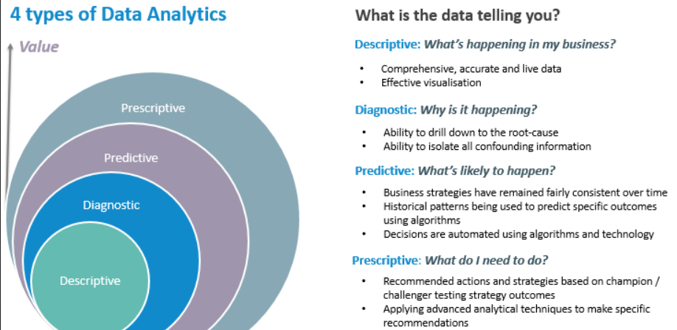

Slide 5
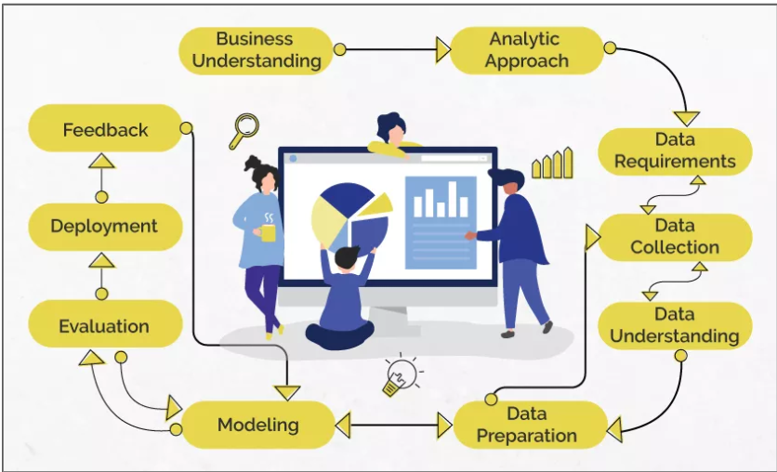
Data Science

Slide 6
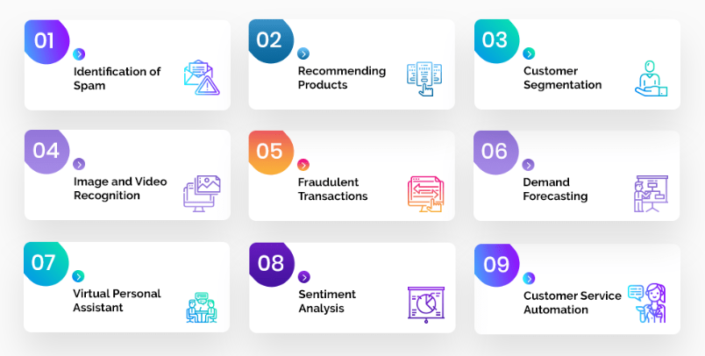
Problem Statement

Slide 7
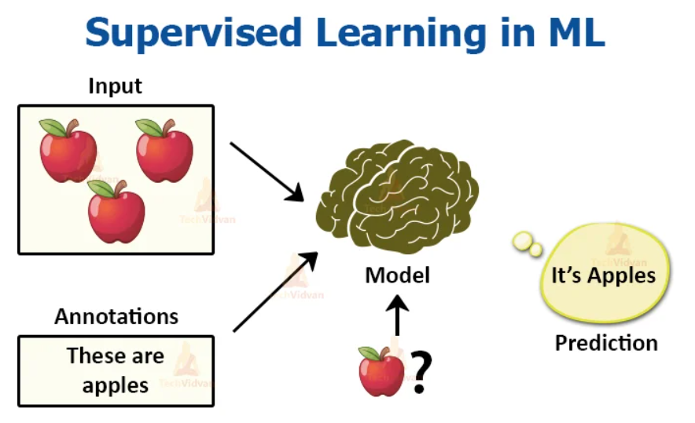
Analytic Approach

Slide 8
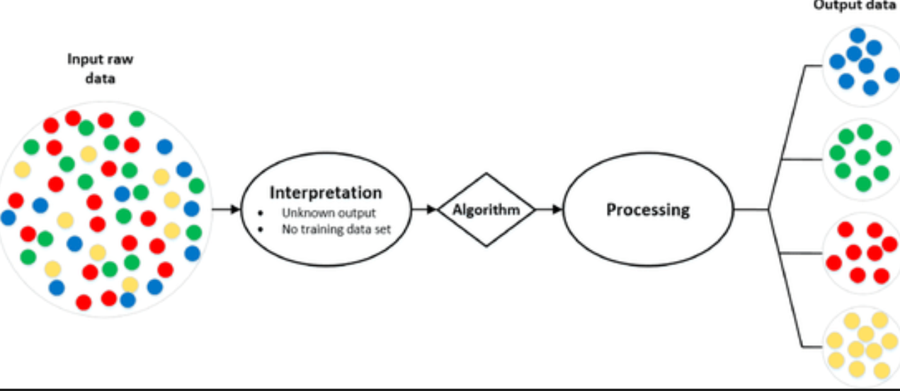
Analytic Approach

Slide 9
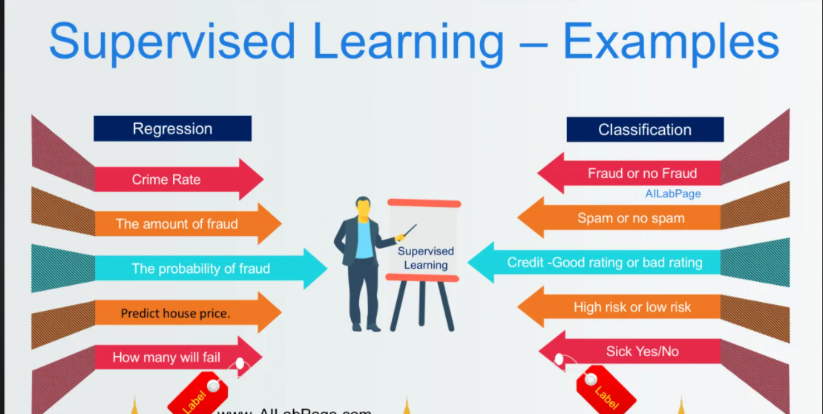
Supervised Learning

Slide 10
Machine Learning
Supervised Learning
Unsupervised Learning

Slide 11
Data understanding
Qualitative
Quantitative
Discrete
Continuous
Categorical
Ordinal

Slide 12
Data preparation
Missing Values
Outliers
Handling Categorical variables
Redundancy in data

Slide 13
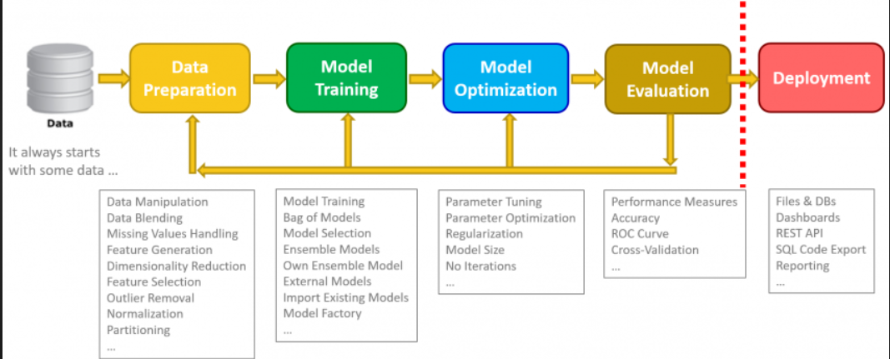
Data Science

Slide 14
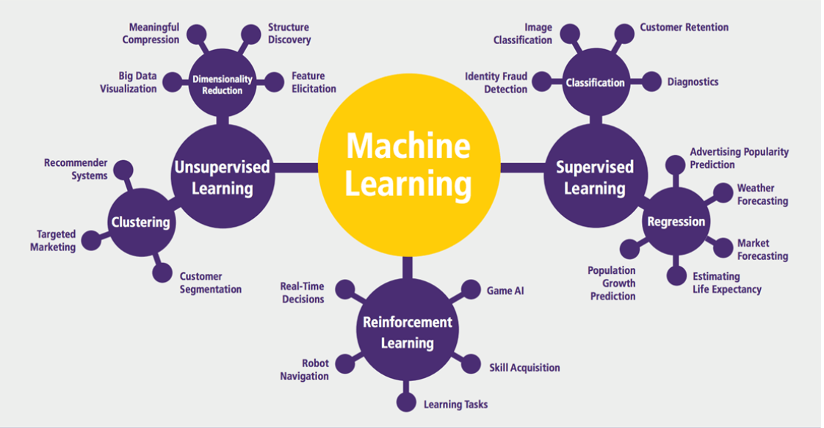
Machine Learning

Slide 15
Applications in Manufacturing
Price Optimization
Predictive Analytics
Demand Forecasting and Inventory Management
Supply Chain Management

Slide 16
Applications in Retail and E-Commerce
Market Basket Analysis
Warranty analytics
Price Optimization
Inventory Management
Location of new stores
Customer sentiment analysis

Slide 17
Applications in Education
Improve Adaptive Learning
Better Assessment of Teachers
Improve Student’s Performance
Better Parent Involvement

Slide 18
Other Applications
Agriculture
Customer Service
Airline Route Planning
Product Recommendation Systems
Digital marketing and Advertising
Internet Search

Slide 19
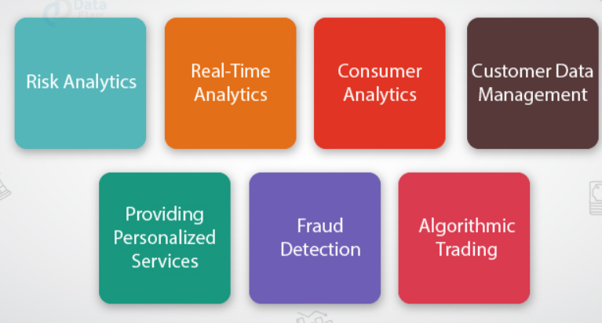
Applications in Finance

Slide 20
Career opportunities
Business Intelligence Analyst
Data Analyst
Data Scientist
Data Engineer
Quantitative Analyst
Data Analytics Consultant
Operations Analyst
Marketing Analyst
Transportation Logistics Specialist
Big data Engineer
Artificial Intelligence researcher
Machine Learning Engineer
Research Scientist
AI Data Analyst
AI Engineer
Robotics Scientist

Slide 21
Questions ????

